Slide 1

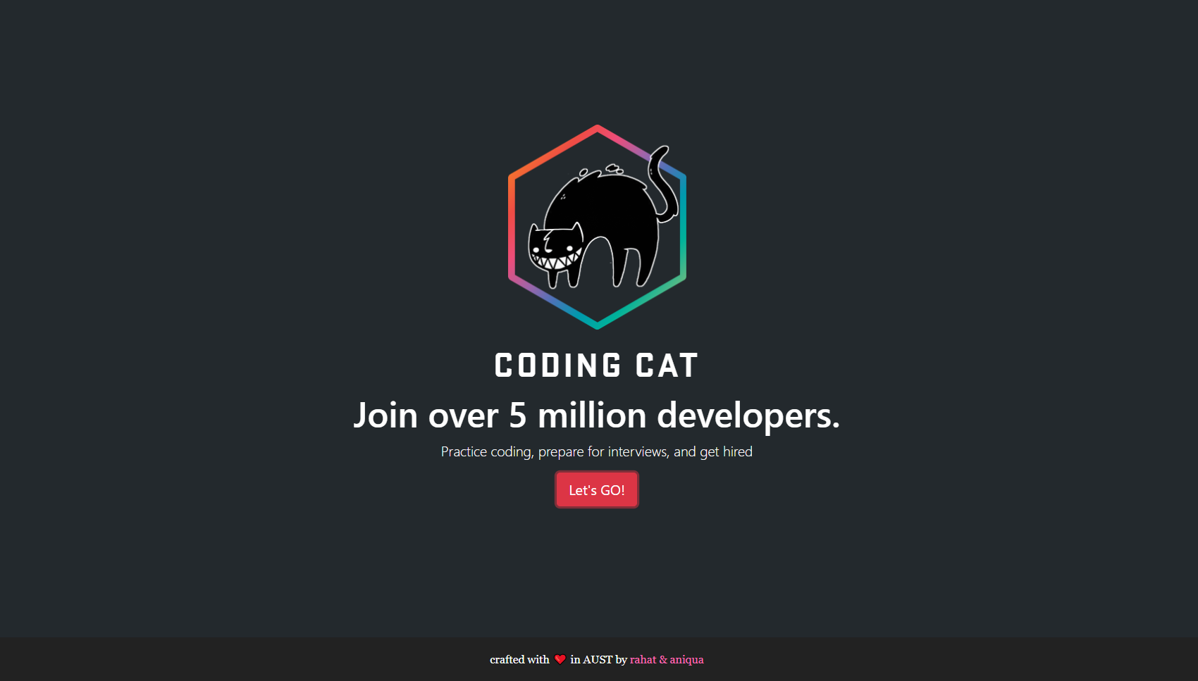


Coding Cat
Ahmad Subaktagin Jabir 16.02.04.061
Arunima Ayshee 16.02.04.066
Rahat Bin Osman 16.02.04.083
Aniqua Tabassum 16.02.04.085

Slide 2
Outline
Introduction to Project
Project Objectives
Study of Existing Systems
Limitation in Existing Systems
Goals of the Proposed System
Types of Stakeholders of the Problem
Feasibility Analysis
Make a Recommendation
Conclusion

Slide 3
Introduction to Project

Slide 4
Introduction to Project
Our Project Coding Cat is an Online Judge where the user will be able to build up their coding skills by solving problems with the help of using their favorite programming language.

Slide 5
Project Objectives

Slide 6
Project Objectives
Result of Submitted Code
Score
Link with Job Offering Companies

Slide 7
Study of Existing System

Slide 8




UVa Online Judge
Codeforces
CodeMarshal
HackerEarth

Slide 9
Limitation in Existing Systems

Slide 10
User Interface Problem
Language Variation Shortage Problem
Absence of Higher Concepts

Slide 11
Goals of the Proposed System

Slide 12
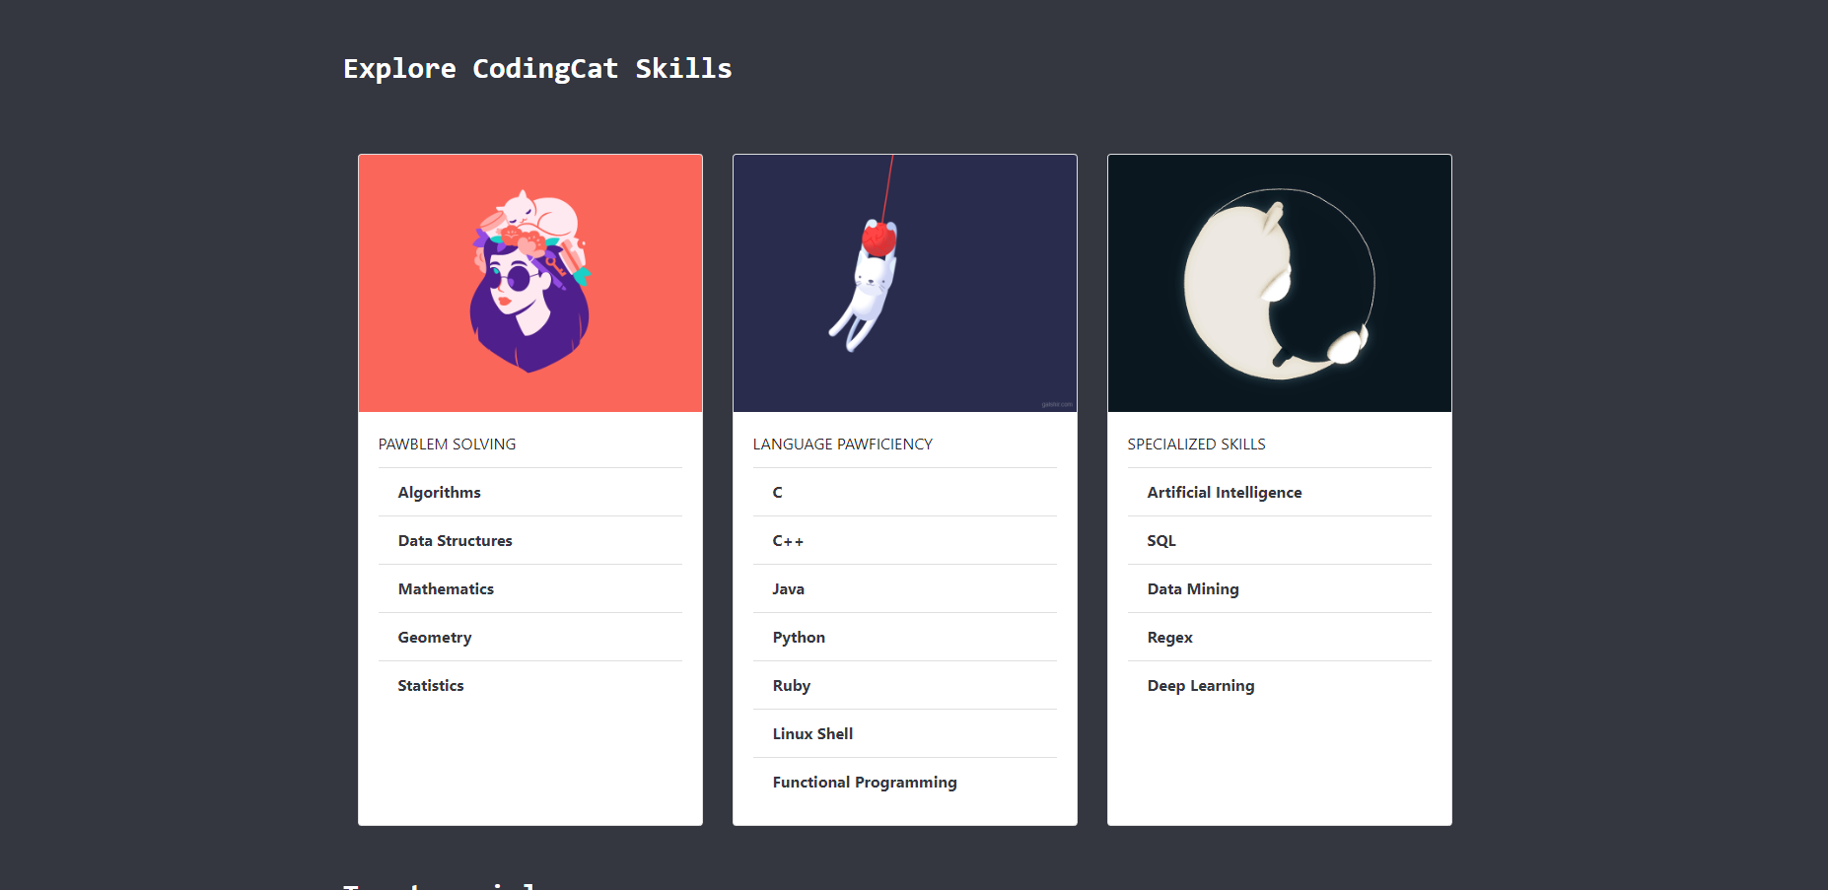


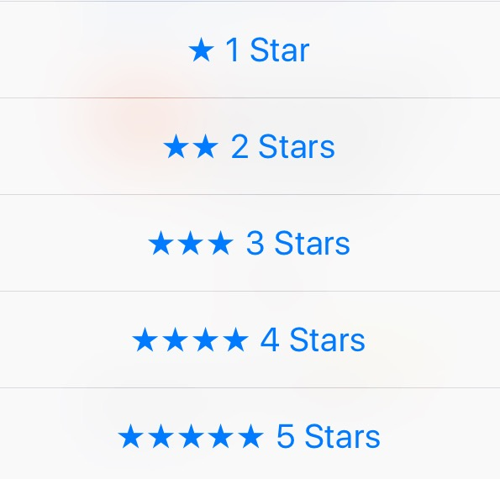

Attractive User Interface
More Language Variation
Inclusion of Higher Concepts
Numerical Rating System
Job Opportunities

Slide 13
Types of stakeholders of the Proposed System

Slide 14



Problem Solver
Problem Setter
Software Development Companies

Slide 15
Feasibility Analysis

Slide 16
Technical Feasibility
Hardware Requirements:
Processor: Pentium IV
Memory: 128 MB RAM or More
Hard Disk Capacity: 40 GB or More
Software Requirements:
Operating System: Windows XP or Higher/Linux/Mac
Front End Tool: Web Browser, Microsoft Visual Studio
Back End Tool: C#, ASP .net, MS SQL, HTML, CSS

Slide 17
Economic Feasibility
Deployment Cost | Domain Cost: 10 USD/year Hosting Cost: 20 USD/year Server Maintenance Cost: 10 USD/year SSL Cost: 5 USD/year
Revenue | Companies Sponsors

Slide 18
Organizational Feasibility
User Types | Reasons for Choosing Our Project
Project Champions and Senior Managements | New and Exciting Features Much Better User Interface
Users | Developing Skills
Job Offering Companies | To find out better candidates

Slide 19
Make a Recommendation

Slide 20
Since our project is feasible from technological, economical and organizational point of view, we would like to move forward with this project, if we have your approval.

Slide 21
Conclusion

Slide 22
We are not entirely familiar with some of the technologies that we are planning to use. We are hoping to get the project done, in spite of our lack of knowledge, that we are hoping will surely increase as we create the project. It is our dearest and most humble request that you see our mistakes in the eyes of forgiveness and guide us through the project so that we can develop our developing skills to make our project, Coding Cat, a complete and successful online judge.

Slide 23
Questions?

Slide 24

Thank You

